Slide 1
Exchange Student Decision Assistant
Denmark Edition

Slide 2
Purpose & Scope
The purpose of the Exchange Student Decision Assistant is to help aspiring exchange students with selecting the University which encompass their interests the most
The scope is to provide students who seek to study in Denmark, within medicine, a quantitative approach to evaluating which university would serve them best

Slide 3
Assumptions
There are three main universities in Denmark, where you can study medicine
University of Copenhagen (Zealand)
Aarhus University (Jutland)
University of Southern Denmark (Funen)
All three universities are equally renowned and provide the same high level of education
The student has no prior preference to either university

Slide 4
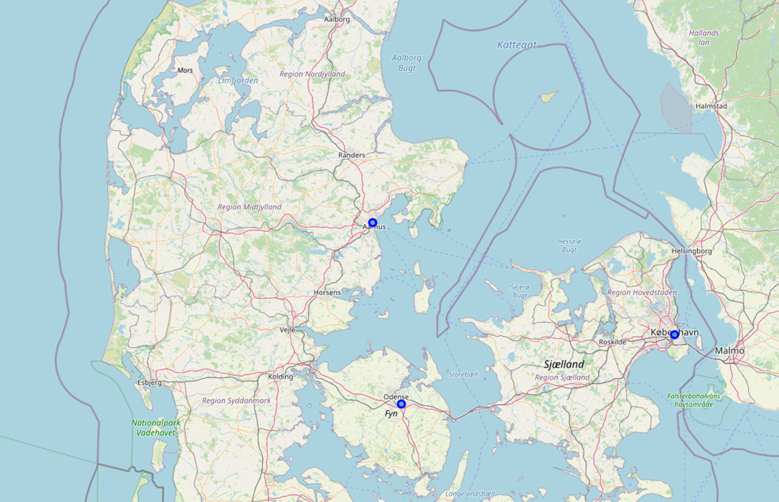
Denmark - Visualization
Denmark consists of three main components (but not limited to)
The island: Zealand
The island: Funen
The peninsula: Jutland
Each university have been
plotted with respect to their
geographic placement
(the blue dots)

Slide 5
Methodology
The data requested through Foursquare is treated in three steps
The count of number of venues within the selected distance is done with respect to each university and venue
Then each university is ranked through the in-built ‘.rank()’ function. As there are three universities the rank can be between 1 and 3. Three being the highest (ie. Most venues within this category)
Then the user input for ‘Weight Factors’ is used to calculate the ‘Match Score’ for each venue type and university. The formula used is the following:
Rank * (1/3) * Weight Factor / 100

Slide 6
Input parameter: Distance
The aspiring exchange student will first have to evaluate the distance (radius) from the universities in which they will explore. The distance (DIST) takes input in the unit of [meter]
It is essential to evaluate what seems reasonable to travel and consider the infrastructure with both regards to public transportation and bicycling (very popular in Denmark)

Slide 7
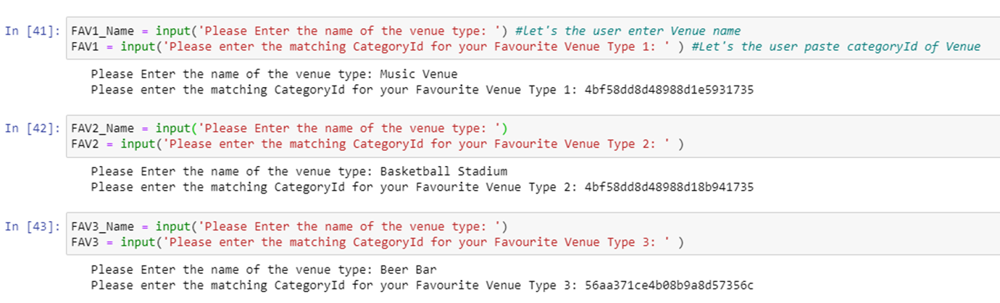
Input parameter: Favourite Venues
Next the student have to select their three favourite type of venues from Foursquare, and pass the Name and CategoryId into the tool

Slide 8
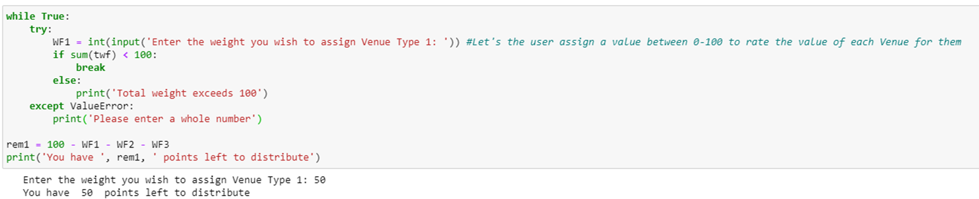
Input parameter: Weight Factor
Last the student will have to rate each of their favourite venues, by distributing 100 points between the three venues. Leading to three different Weight Factors (the example below is for one weight factor)

Slide 9
Output
Based on the input provided by the exchange student the tool provides output in three phases, before the final recommendation is presented
Phase 1 – Count
Phase 2 – Rank
Phase 3 – Match Score
Recommendation

Slide 10
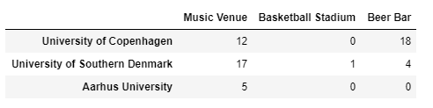
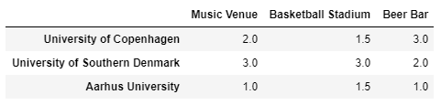
Output: Phase 1 & Phase 2
Phase 1: Count of venues within the chosen distance for each university
Phase 2: Ranking of each university with respect to Venue

Slide 11
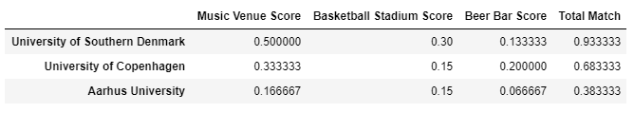
Output: Phase 3 & Recommendation
Phase 3: Match Score calculated
Recommendation: Final recommendation for choice of University based on user input

Slide 12
Conclusion
In conclusion the ‘Exchange Student Decision Assistant’ is a strong tool for helping exchange students, to decide where to study in Denmark, based on their own favourite types of venues
For future development, it could be considered to implement ‘geopy’ and hence make the current static parameters of universities in Denmark be dynamic instead. Furthermore, it can be considered to increase the number of venues to be part of the decision process

